Slide 1
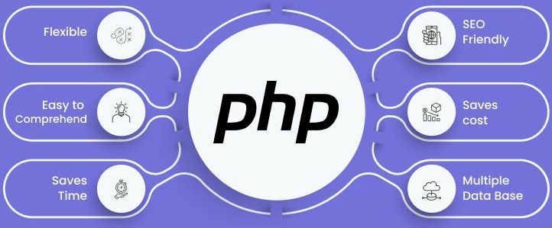

Slide 2
About today…
Object Oriented Programming
Class
Object

Slide 3
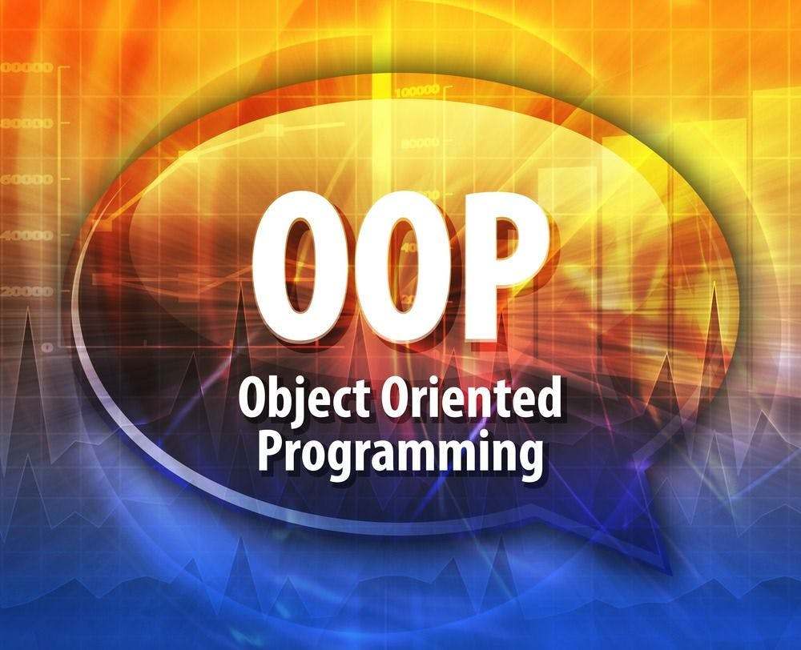

Slide 4
Intro to OOP
OOP is a programming paradigm that uses objects and classes to structure code
Importance
Enhances code organization, reusability, and maintainability
Key Concepts
Classes
Blueprints for creating objects
Objects
Instances of classes
Inheritance
Mechanism to create new class using properties/methods of existing class
Polymorphism
Ability to process objects differently based on their data type or class
Encapsulation
Bundling data and methods within classes
Abstraction
Hiding complex implementation details and showing only the necessary features

Slide 5
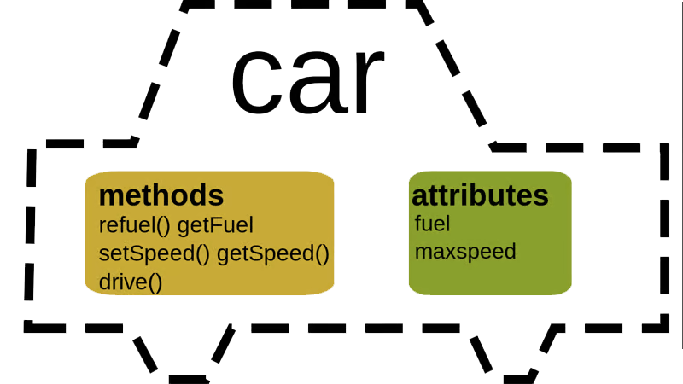
What is a Class?
Definition
Blueprint for creating objects, encapsulating data for the object and methods
to manipulate that data
Analogy
Think of a class as a template for creating objects, like a blueprint for building houses
Example
Class Car with properties make, model, and year.
Methods like startEngine() and stopEngine()

Slide 6
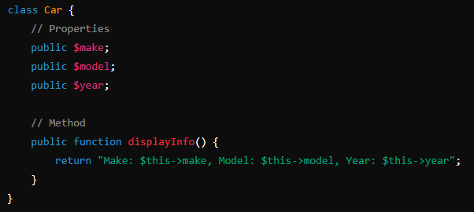
Defining a Class in PHP
Properties
Variables defined within the class
Methods
Functions defined within the class to manipulate the properties

Slide 7
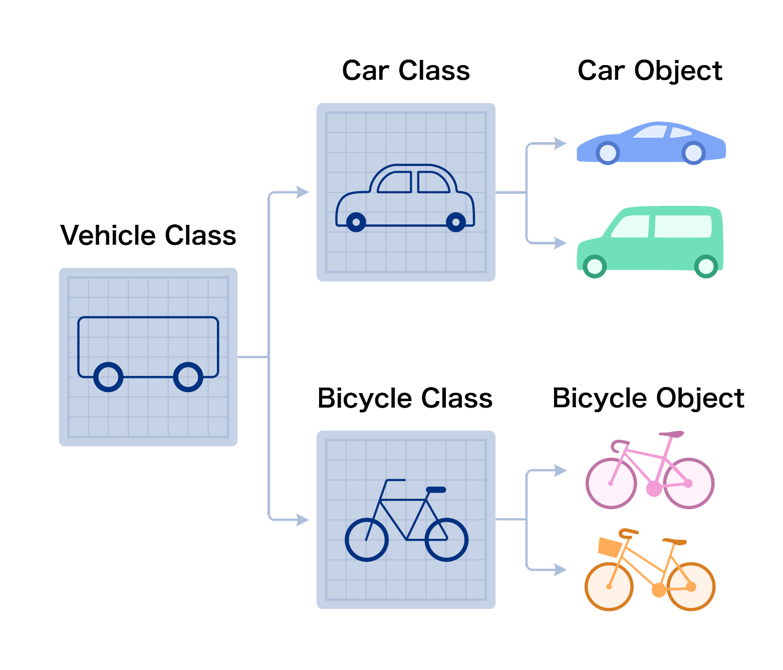


What is an Object?
Definition
An object is an instance of a class
Analogy
If a class is a blueprint, an object is a house built from that blueprint
Example
Creating an object of the Car class:
The new keyword is used to create an instance of a class

Slide 8
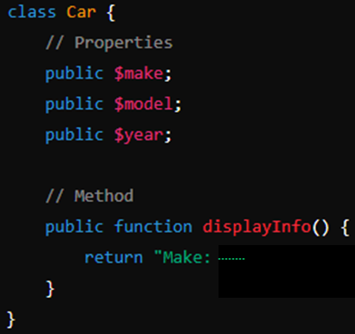


Setting Properties of an Object
Use the -> operator to set the properties of an object
Accessing Methods of an Object
Use the -> operator to call methods of an object

Slide 9


Slide 10

What is Object-Oriented Programming?
What is a class in PHP?
What keyword is used to create an instance of a class in PHP?
How do you access a method of an object in PHP?
Which operator is used to set and get properties of an object in PHP?

Slide 11

Task 1
Create a PHP file named Car.php and define a class Car with properties make, model, and year. Add a method displayInfo() that returns a string with the car's details
Task 2
Create a PHP file named Person.php and define a class Person with properties name and age. Add a method introduce() that returns a string introducing the person.

